Slide 1

Regression
Chapter 16

Slide 2
Regression
Builds on Correlation
The difference is a question of prediction versus relation
Regression predicts, correlation describes relations

Slide 3
Simple Linear Regression
A statistical tool that lets us predict an individual’s score on the DV based on the score on one IV
Multiple linear regression uses more than one IV

Slide 4
Linear Regression
a = Intercept: predicted value of Y when X is equal to 0
Mean of Y
b = Slope: the amount that Y is predicted to increase for an increase of 1 in X

Slide 5
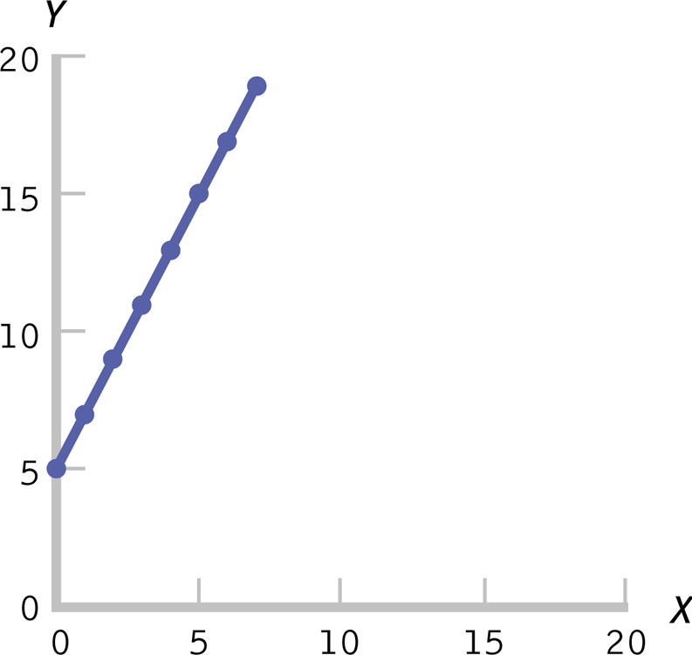
The Equation for a Line

Slide 6
Standardized regression coefficient
Statisticians love to standardize things.
Beta = standardized coefficient
It’s a z score of the slope value
WHY? Comparisons.
Beta = r with ONE predictor!

Slide 7
Assumptions
Random selection
X and Y are at least scale variables
X and Y are both normal
Homoscedasticity (for real this time!)
Each variable must vary approximately the same at each point of the other variable.
See scatterplot for UFOs, megaphones, snakes eating dinner.

Slide 8
Hypothesis Steps
Step 1:
Population: people where IV does not predict DV (i.e. b = 0)
Sample: people where IV does predict DV

Slide 9
Hypothesis Steps
Step 2:
Null: No relationship between pronouns and social words (b = 0)
Research: Relationship between pronouns and social words (b/=0)
(just an example, using data from RP3 in class)

Slide 10
Hypothesis Steps
Step 3:
List regression equation
Notice relationship between beta and r
List the df = N – 2

Slide 11
Hypothesis Steps
Get the equation:
output = lm(DV ~ IV, data = data)
summary(output)

Slide 12
Hypothesis Steps
Get beta!
Install the QuantPsyc library.
library(QuantPsyc)
lm.beta(model)

Slide 13
Hypothesis Steps
Step 4
List the cut off score p < .05
qt(.05/2, df, lower.tail = F)

Slide 14
Hypothesis Steps
Step 5:
List the t value
(don’t use the constant)

Slide 15
Hypothesis Steps
Step 6:
Reject or fail to reject!

Slide 16
Hypothesis Steps
Effect size
R² = proportionate reduction in error
Same rules as ANOVA applies
S = .01
M = .06
L = .14
It’s at the bottom of the output.
This effect is for ALL predictors.

Slide 17
Proportionate Reduction in Error
Also called the coefficient of determination
Quantifies how much more accurate our predictions are when we use the regression line instead of the mean as a prediction tool
Explaining what R² actually means

Slide 18
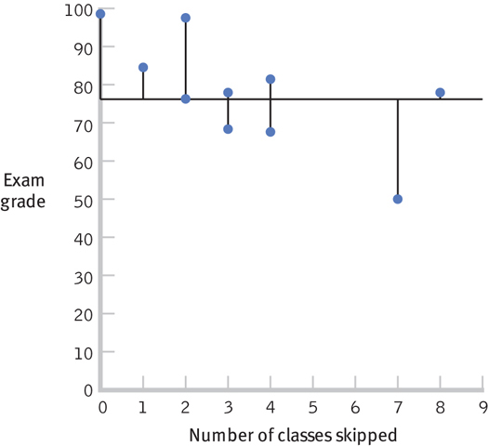
Visualizing Error

Slide 19
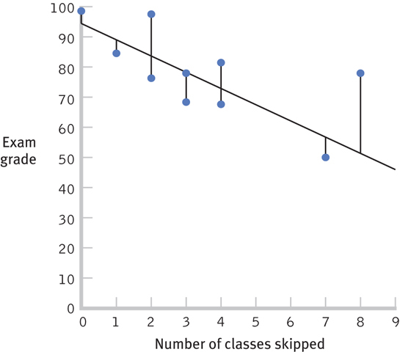
Visualizing Error

Slide 20
Regression Issues
Standard error of the estimate
Regression to the mean

Slide 21
Interpretation and Prediction
Standard error of the estimate
Indicates the typical distance between the regression line and the actual data points
Often called least squared error

Slide 22
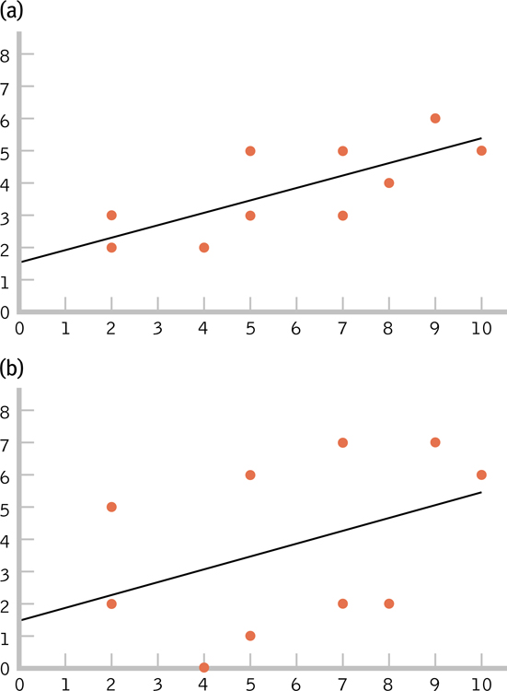
The Standard Error of the Estimate
Which figure makes the stronger prediction? Why?

Slide 23
Regression to the mean
The patterns of extreme scores

Slide 24
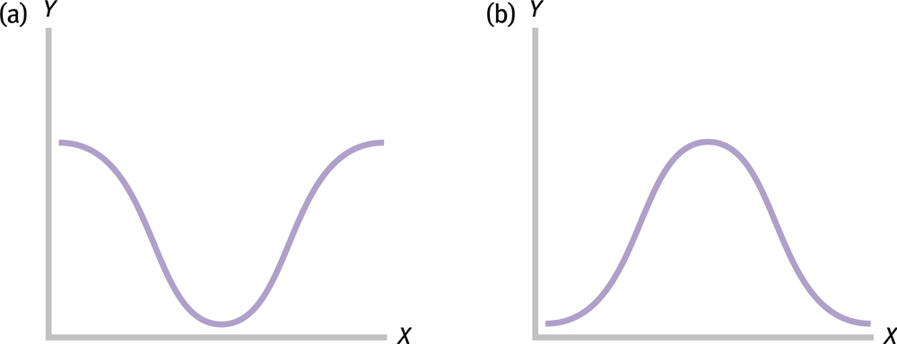
Regression to the Mean

Slide 25
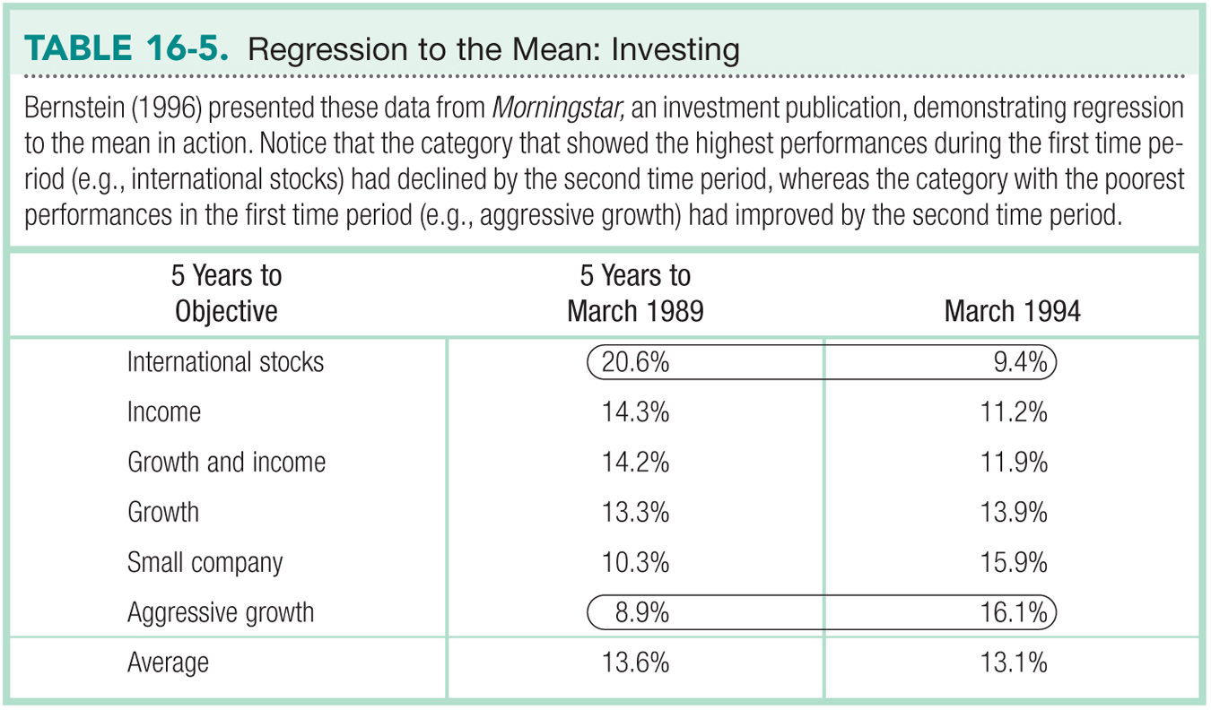

Slide 26
Other Regression Techniques
Multiple Regression
Stepwise Regression
SEM

Slide 27
Multiple Regression
A statistical technique that includes two or more predictor variables in a prediction equation

Slide 28
Stepwise Regression
A type of multiple regression in which computer software determines the order in which IVs are included in the equation.
It is the default in many computer software programs.
The strength of using stepwise regression is its reliance on data, rather than theory— especially when a researcher is not certain of what to expect in a study.

Slide 29
Structural Equation Modeling (SEM)
A statistical technique that quantifies how well sample data “fit” a theoretical model that hypothesizes a set of relations among multiple variables.
SEM encourages researchers to think of variables as a series of connections.

Slide 30
